Slide 1


Software Project Midterm Presentation
Group 11A
Client: Unetiq BV
Coach: Thomas Overklift
TA: Oskar Lorek
Kendra Sartori
Lucian Negru
Ahmed Ibrahim
Manar Al-Robayi
Radu Constantinescu
Notes:
Good morning, and welcome to the Software project midterm presentation of our group. As you might already know us we are (read names).
First of all we would like to welcome all of you, we are joined by our coach: Thomas, our TA: Oskar, and our clients from Unetiq, Stefan and William.
Today we will showcase the current progress of our project as of week five by giving you a detailed overview of everything so far.

Slide 2
Table of Contents
Problem
Problem Statement
Market Survey
Existing Solutions
Product
Functionality Demo
System Architecture
Frontend
Backend
Algorithm
Design Patterns
Notes:
Specifically, today we structured our presentation on two main topics: The Problem we were assigned to solve, and The Product we came up with to do so.
We will begin by describing what the problem is, after that we will reflect on the market research, from which we will continue by reviewing currently existing solutions. Afterwards, we show a demonstration of the functionality, discuss the architecture of the system and the design patterns used.

Slide 3
Table of Contents
Process
Team Reflection and Potential Improvements
Challenges Faced
Planning for the Coming Weeks
Conclusion
Q&A Session
Notes:
Finally, we will reflect on our teamwork so far as well as the various challenges we faced. We will talk about what is left for the coming weeks and wrap everything up in a conclusion. Afterwards, we will have a Q&A session where all of you can ask us anything.

Slide 4
Order Processing System
Our Problem Analysis
Notes:
We will now go into detail about the problem our project aims to solve.

Slide 5

Problem Statement
Ordering products online and in bulk is very tedious.
Many businesses store their order lists as Excel files and PDFs.
These files then have to be read by someone and manually inputted into the online shop. This wastes a lot of time.
Not an ideal situation.
Notes:
To deliver a satisfying product which tackles the issue at hand, we have to first understand the problem. Ordering large quantities of products can be tedious and time-consuming for the customer as well as for those responsible for the processing. Manufacturing businesses are greatly affected by this, as they often order large quantities of small, unnamed and similar products. Because of this, businesses can spend a lot of time having manually processing these large orders, when they could be focusing on other areas of their business.
Many business prefer to store their lists of products for order in an Excel document or PDF. These documents need to be manually processed by someone, either the customer or the shop employee receiving the files as order requests. Our client tasked us with devising a solution to this problem, in the form of an Order Processing System.
My colleague Kendra will now discuss the market research and existing products.

Slide 6
Market Survey
Annually in the US, 17 trillion dollars are spent in manufacturing and distribution orders, out of which 50% of it is manually processed [1].
“Before we deployed Palette Invoice, our invoicing system was labor-intensive and time-consuming for staff. Automated processing has significantly increased our overall efficiency, shortened payment cycles, and helped to improve the manageability of transactions.” - Emily Grantham, AP Supervisor at Landstar System inc. [2]
69% of the surveyed organisations managed to decrease issues with customer satisfaction by integrating intelligent automation [3].
Notes:
Before we could begin with designing such a system we had to research how sit would impact the market and the businesses using it. We have looked over research conducted by other companies in the intelligent automation sector regarding the need and the effect of such a product.
A lot of money is spent manually processing purchase orders in the manufacturing and distribution industries, up to 50% of their purchases are processed manually by the customer or employee.
Businesses that have already implemented similar solutions have seen a large improvement in customer satisfaction as well as employee satisfaction.
It was clear from our research that such a system would benefit businesses that implement it as there is clearly a need for it.

Slide 7



Existing Solutions
Some products with similar functionality:
Conexiom
Tipalti Approve
Palette Automated PO Software (now Rillion)
Notes:
There are quite a few companies that are tackling the issue with order processing. Some of which we have listed here. Many of these implementations make use of AI to process the data and then request the processed orders. These systems also accept various file types, but all of them have one thing missing. They require the user to order through a separate app that connects to the shops website. Since we want our system to be more streamlined and user friendly, we are designing it to be able to be implemented in any website backend.
Now, my teammate Radu will elaborate more on the architecture.

Slide 8
Order Processing System
Our Product Proposal
Notes:
Thank you Kendra. In the following section we will, as you said, dive deep into the architecture and later on we will make a showcase of the current progress.

Slide 9



Proposed Solution - Architecture
Choosing the technology stack!
Notes:
Now at this stage, it is time to talk about our chosen technology stacks.
Obviously, this is no trivial step of the process of constructing the product, yet in our case some aspects made it easier for us to decide on them.
Firstly for the front end, the decision was rather straightforward, since our client gave as the non-functional requirement for choosing REACT as our frontend library.
======
In fact, despite this requirement, we could only agree with this choice since this library provides proper speed, flexibility, performance and usability. And to not forget, it lets you create reusable components, which for our use case would fit best in making the work more compact.
As for the backend, since our main task deals with processing and predicting data, there was no better choice than python because of the already existing libraries like pandas and numpy that offer a lot
=====
Speaking of out of the box, django is one python production ready based framework that offers a lot of functionality already that would suit our needs.
=====
By having made those choices, we can already almost hint towards the database, which eventually will be POSTGRESQL, despite having chosen another one initially.

Slide 10
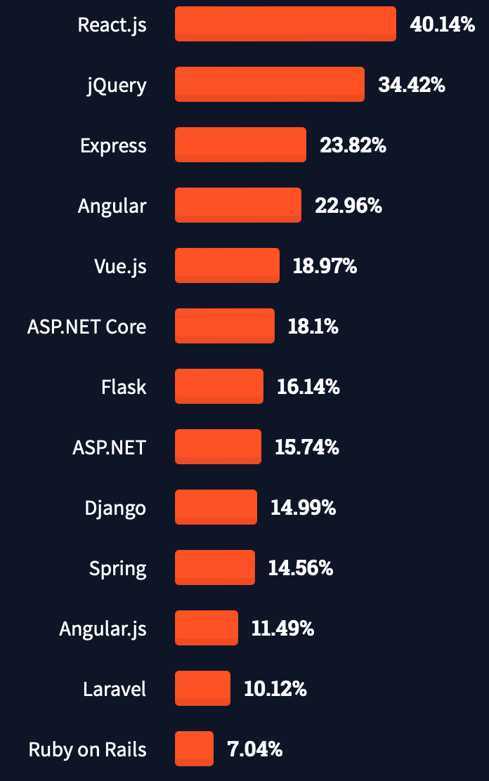
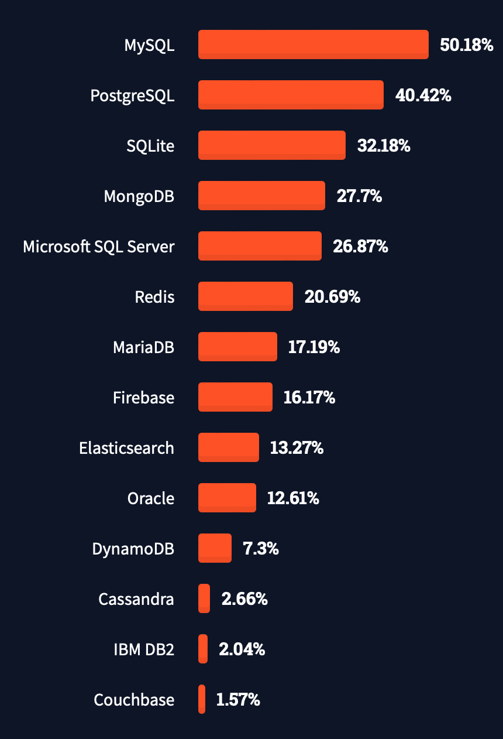
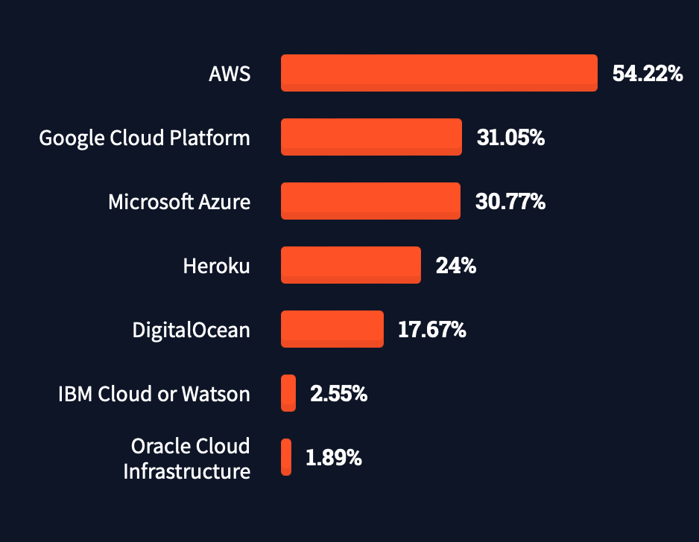
Proposed Solution - Architecture
StackOverflow 2021 Developer Survey
Notes:
In addition to the all the previously mentioned reasons of choosing this technology stack. We can also look at popularity, and according to the 2021 Stack Overflow Developer Survey, it seems that our choices are rather popular among developers.
And not to forget, in match with the statistics, we are also using AWS as a storage solution.

Slide 11
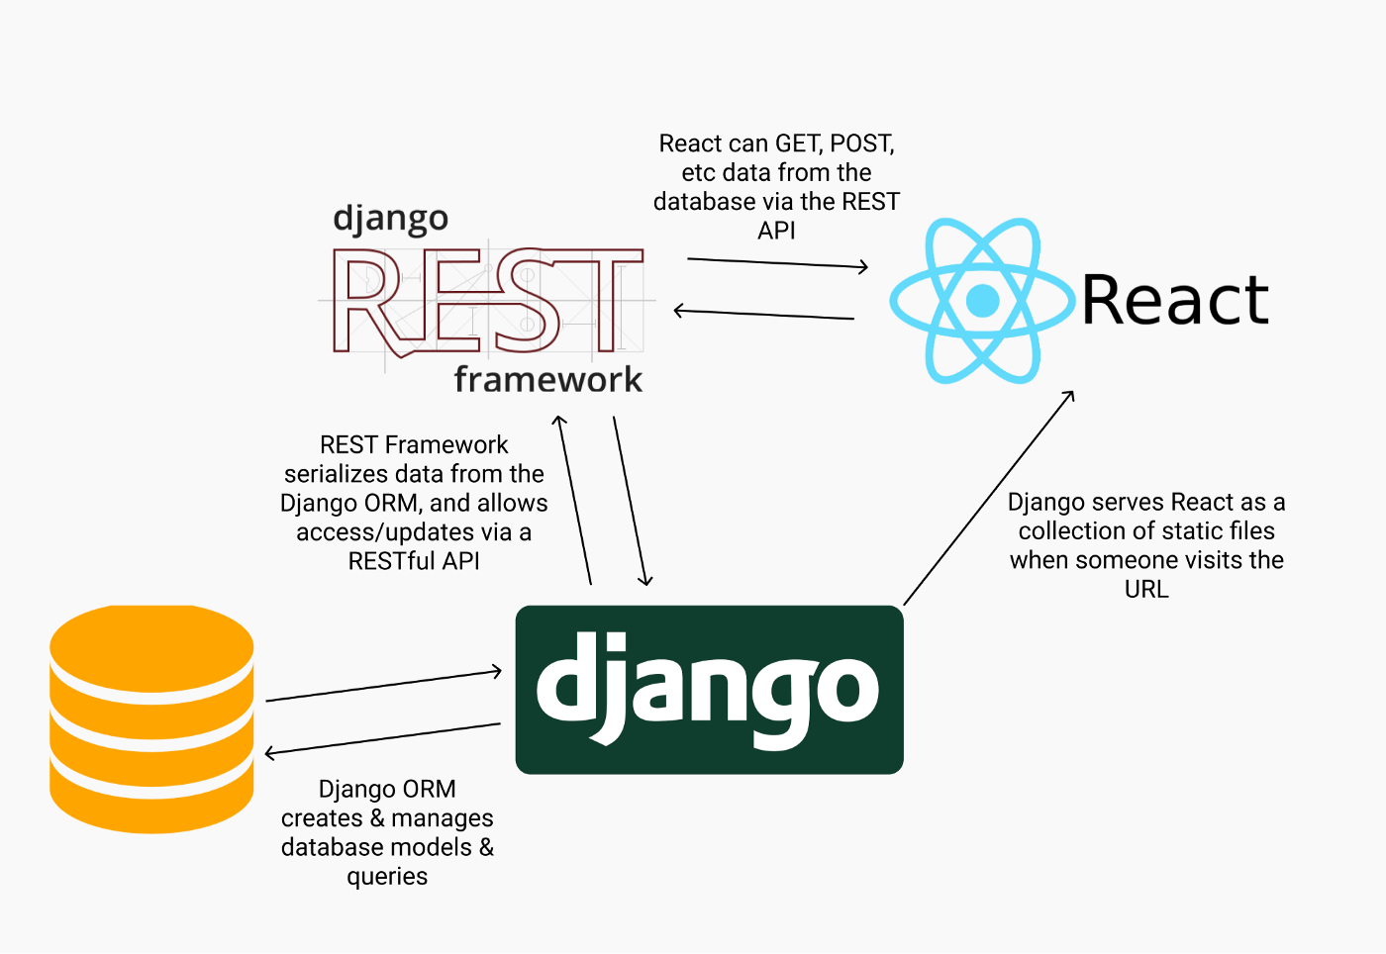
Proposed Solution
Notes:
Having said all of the above, the overall architecture and interaction between technologies would look as follows:
Django, on the server side, on request would serve the client the react application as static files, which when in use it will keep a constantly “reactive” interface through its nature, and would communicate with the database back using the integrated Django REST API framework.
Moving on to a more friendly and yet naive schema:

Slide 12
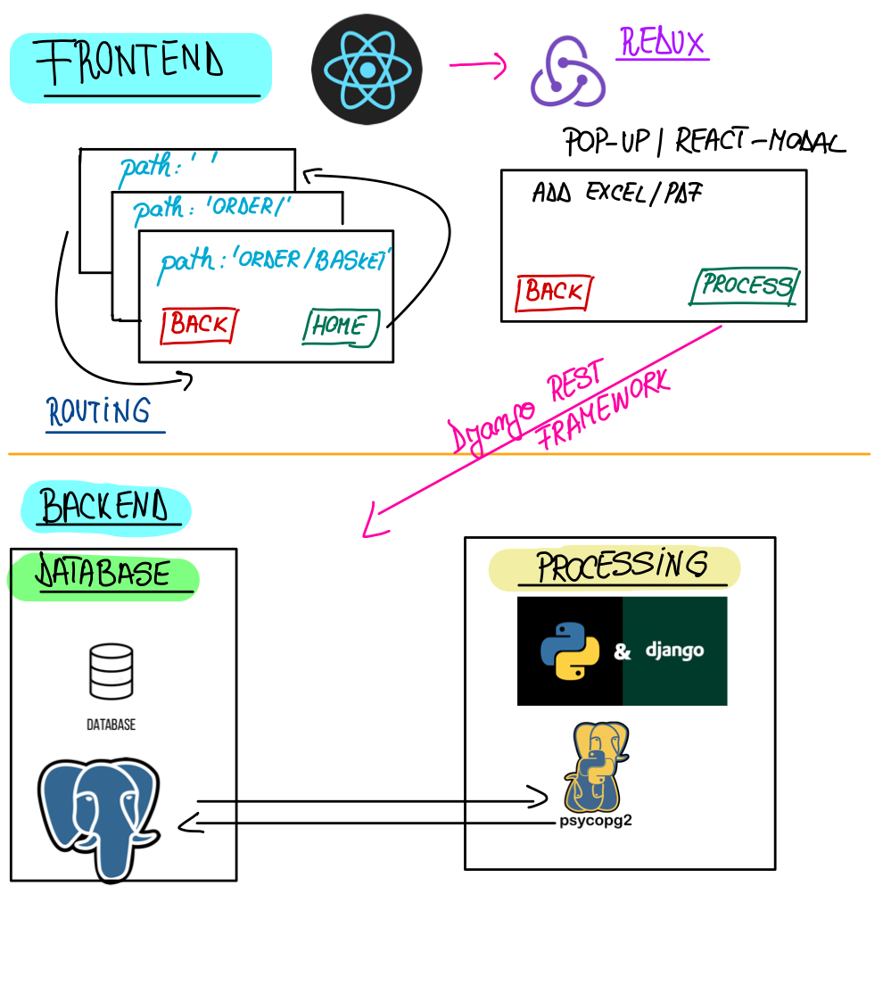
Notes:
Here you can see our focus was on functionality rather than aspect. Our frontend was reduced to 3 main views, which would be the homepage, order page, and basketpage.
For those views, a file of your preference can be uploaded, later on passed to the backend using a Django Post Request, and receive as a response a json file that would
For a more clear picture of all project progress let's dive into a live demo with Ahmed!

Slide 13
Showtime
Notes:
Thank you Radu, I will now demonstrate how our system works.

Slide 14
Order Processing System
Team Process
Notes:
Thank you Ahmed for the demo. In the following section we will be reflecting on our teamwork and possible improvements, look back on the challenges we faced until now, discuss what the next steps are and conclude everything.

Slide 15
Team Reflection and Potential Improvements
Positive aspects of our teamwork:
Each team member has different skills they bring to the table
We didn’t hesitate to help each other out
Availability of working together
Areas to improve on:
Better communication of ideas
More involvement in the decision-making process from all team members
Better splitting of tasks
Notes:
We believe we worked well together in the past few weeks. There are many strong suits of this team, some of which are pointed out here, which helped us get as far as we did with this project. However, like any team, we also have areas we can improve. These areas consist of communication mostly, either that of ideas or decisions. We can also improve the way we split tasks in order to reduce some of the pressure before a sprint deadline. All in all, we are satisfied with our teamwork and look forward to completing this project together.

Slide 16

Challenges Faced
Setting up the database
Managing the assignments alongside the project
Underestimating the un-structured nature of the Excel files.
Team communication issues
Notes:
Some of the biggest challenges we faced, are mentioned here. These are issues that we have learnt from and will strive to improve on by the end of the project. Setting up the database was a challenge because we had to learn how to use Django and also decide between the use of DynamoDB or a PostgreSQL database. We initially tried the former but encountered many issues so we switched to the latter. Managing the assignments was also difficult as it required us to each write a lot and try to combine our work into something concise and clear. We underestimated the excel files as they proved to be a lot more unstructured than we initially thought. This led to delays in setting up the database, mentioned before, and delays in the processing algorithm being completed. Team communication issues which were mentioned in the slide prior were also part of the challenges.

Slide 17
Planning for the Coming Weeks
Measure the accuracy on all data objects
Improve accuracy
Add search bar functionality
Apply machine learning to learn the column labels
Is it better than the approach we already have?
Try to process PDF files
Notes:
The main tasks that still need to be completed in the final weeks are stated here. They consist on accuracy calculations, UI functionality, an alternative implementation for the file processing and lastly processing the PDF files if time allows.

Slide 18
Final Thoughts
Notes:
In conclusion, we believe that we are on track to delivering a satisfying product for our client. We have taken great consideration in the quality of both the software and design of our system, making sure they align with the given requirements. We believe our process as a team was largely positive and has helped us greatly in staying on-track throughout the past few weeks.
Thank you very much for joining our presentation.

Slide 19
References
[1]. Conexiom. (2021) Don’t Wait to Automate. [Online]. Available: https://conexiom.com/resources-category/infographics/
[2]. A. Affairs, “Prototyping | usability.gov,” 2022. [Online]. Available: https://www.usability.gov/how-to-and-tools/methods/prototyping.html
[3].Capgemini. (2018) Consumers are embracing AI and will reward organizations that offer more human-like AI experiences. [Online]. Available: https://www.capgemini.com/us-en/news/consumers-are-embracing-ai-and-will- reward-organizations-that-offer-more-human-like-ai-experiences/

Slide 20
Questions?
Notes:
We will now begin a q&a session where we can answer your questions.

